Slide 1
Asymmetric key Cryptography
Public key Cryptography

Slide 2
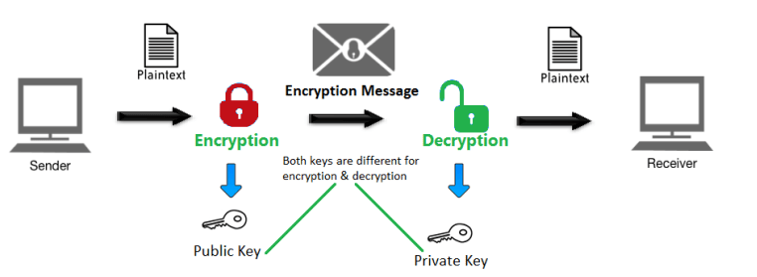

Slide 3
Introduction
Public key cryptography involves a pair of keys known as a public key and a private key (a public key pair), which are associated with an entity that needs to authenticate its identity electronically or to sign or encrypt data.
Each public key is published and the corresponding private key is kept secret.
Data that is encrypted with the public key can be decrypted only with the corresponding private key.

Slide 4
Elgamal cryptography
The ElGamal encryption system is a public key encryption algorithm by Taher Elgamal in 1985.
It is based on the Diffie-Hellman key exchange.
Steps followed:
Key generation
Encryption
Decryption

Slide 5
The ElGamal Algorithm provides an alternative to the RSA
for public key encryption.
1) Security of the RSA depends on the (presumed) difficulty of factoring large integers.
2) Security of the ElGamal algorithm depends on the difficulty of computing discrete logs in a large prime modulus.
ElGamal has the disadvantage that the ciphertext is twice as long as the plaintext.
It has the advantage the same plaintext gives a different ciphertext each time it is encrypted.

Slide 8
RSA Algorithm
The RSA algorithm is an Asymmetric cryptography algorithm; this means that it uses a public key and a private key (i.e two different, mathematically linked keys). As their names suggest, a public key is shared publicly, while a private key is secret and must not be shared with anyone.
The RSA algorithm is named after those who invented it in 1978: Ron Rivest, Adi Shamir, and Leonard Adleman.

Slide 9
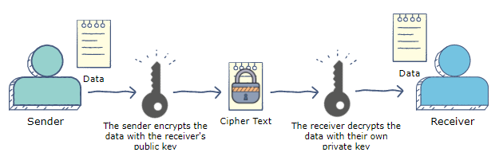

Slide 10
Euler’s Totient Function
To know how many prime numbers are coming up to the given integer ‘n’ Euler’s Totient Function is used. It is also called an arithmetic function.
For an application or use of Euler’s Totient function, two things are important.
One is that the gcd formed from given integer ‘n’ should be multiplicative to each other, and the other is the numbers of gcd should be the prime numbers only.
The integer ‘n’ in this case should be more than 1. From a negative integer, it is not possible to calculate the Euler’s Totient Function. The principle, in this case, is that for ϕ(n), the multiplicators called m and n should be greater than 1. Hence denoted by 1<m<n and gcd (m, n) = 1. Sign ϕ is the sign used to denote Totient Function.

